Slide 1

Spring Framework
Quick Summary

Slide 2
Spring Modules
-IoC Container
-DI
-AOP
-Spring MVC
DI
Dependency Injection (DI) is a design pattern that removes the dependency from the programming code so that it can be easy to manage and test the application. Dependency Injection makes our programming code loosely coupled.
IoC Container
The IoC container is responsible to instantiate, configure and assemble the objects. The IoC container gets information from the XML file and works accordingly.
The main tasks performed by IoC container are:
to instantiate the application class.
to configure the object.
to assemble the dependencies between the objects

Slide 3
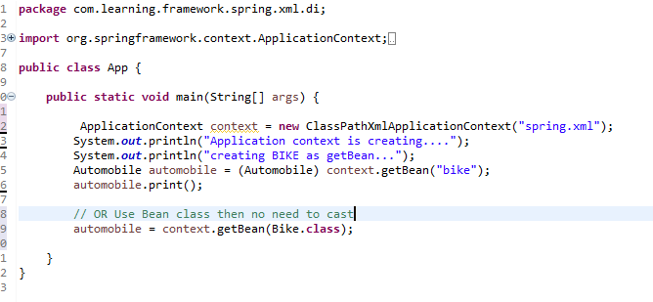
Ways to Configure IOC
BeanFactory
ApplicationContext
The ApplicationContext interface is built on top of the BeanFactory interface. It adds some extra functionality than BeanFactory such as simple integration with Spring's AOP, message resource handling (for I18N), event propagation, application layer specific context (e.g. WebApplicationContext) for web application. So it is better to use ApplicationContext than BeanFactory
Ways configure IOC:
1. XML Based 2. Annotation based 3. Java Based

Slide 4
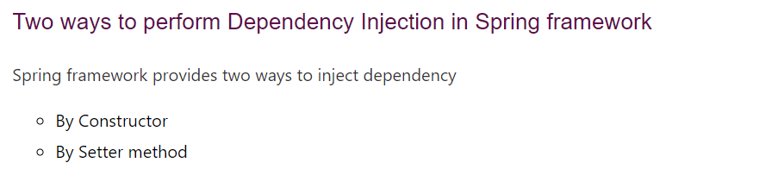
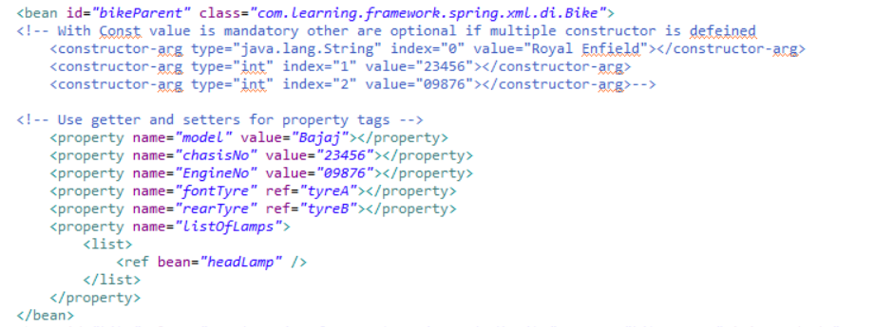
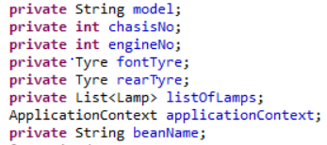
Spring DI

Slide 5
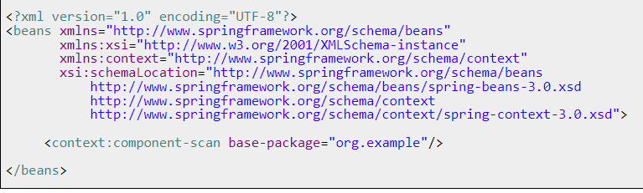
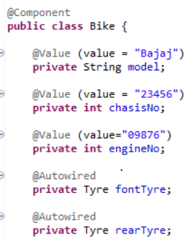
Annotation Based Config
Add the following in spring.xml file
Steps →
Use @Component for class to make it as a Bean
Component-scan in spring.xml as it will scan the base package for @component

Slide 6
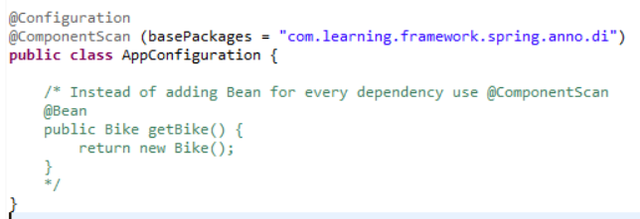
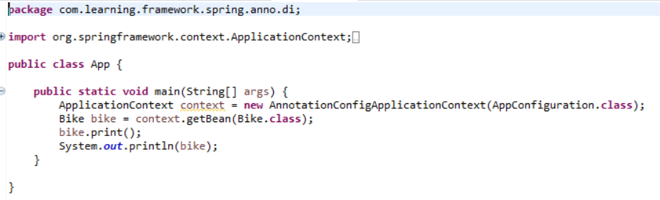
JAVA Based Config
Create a Config class & add @Configuration and @ComponentScan OR Use @Bean if not used @Component
Use @Component to create Bean
Use AnnotationConfigApplicationContext

Slide 7

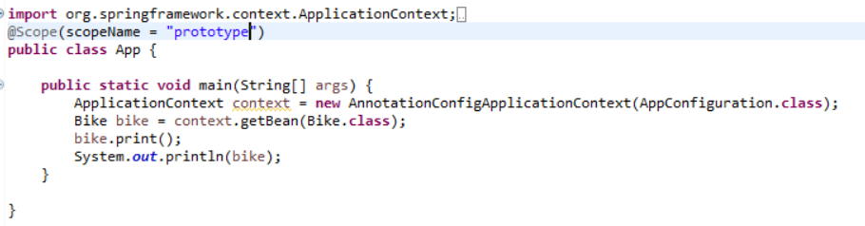
Bean Scope
By default Singleton → here initialization by Application Context is done before getBean() method
Prototype where it will request Load Bean each and everytime → here initialization by Application Context is not done. Only after getBean() method

Slide 8
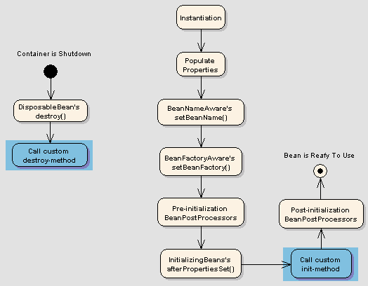
Bean Lifecycle

